Slide 1
Techno timesaving tricks
Alissa Carter
Instructional Technology coordinator
Plainview independent school district

Slide 2
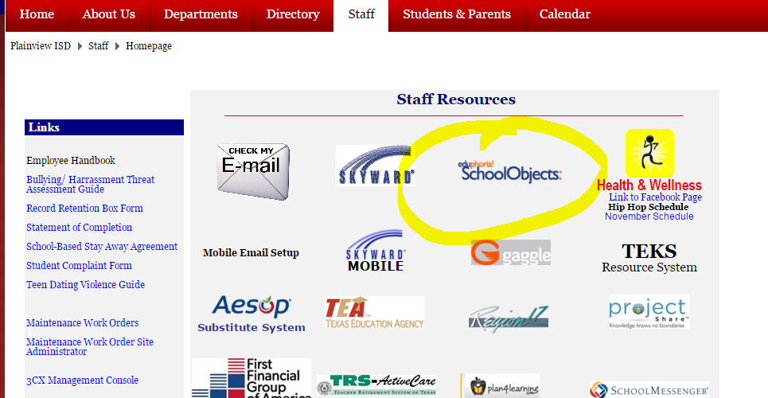
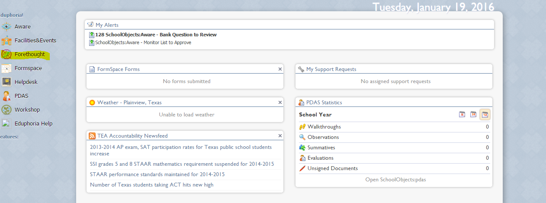
Eduphoria
Lesson Plans - Forethought– Material Management

Slide 4
Eduphoria -handout

Slide 5
Microsoft Outlook
View your inbox your way
Multiple email accounts
To Do Bar
Quick Step
Rules
Calendar

Slide 6
Classroom Management tools
Class Dojo– ClassDojo is a classroom tool that helps teachers improve behavior in their classrooms quickly and easily. It also captures and generates data on behavior that teachers can share with parents and administrators.
Bouncy Balls uses the increased agitation of multicolored and sized balls to indicate sound level.
Online Stopwatch includes analog and digital timers as well as an egg timer, stopwatch (count up or down), talking clock, metronome, chess clock, an interval timer, and split lap timer. Timers can be displayed full screen and on interactive whiteboards.
Too Noisy App-related noise monitors, o are ideal for small group settings (free one available – too noisy lite online)

Slide 7
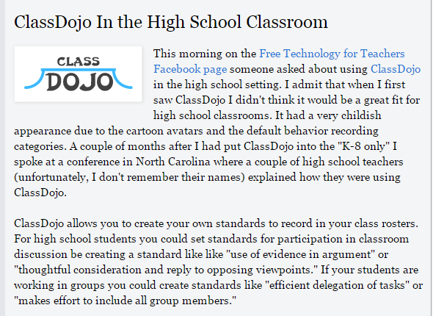
Class Dojo

Slide 8
Class Dojo
Great explanation of ClassDojo Tutorial (video)
How to add behavior standards (video)
ClassDojo and Middle School Students (article)
ClassDojo and High School Students (article)
Lots of Info from the Help Desk of ClassDojo (links)
An Apprehenisive Teacher’s Guide to ClassDojo (article)
Encouraging Active Listening in High School (YouTube)

Slide 9
Too Noisy

Slide 10
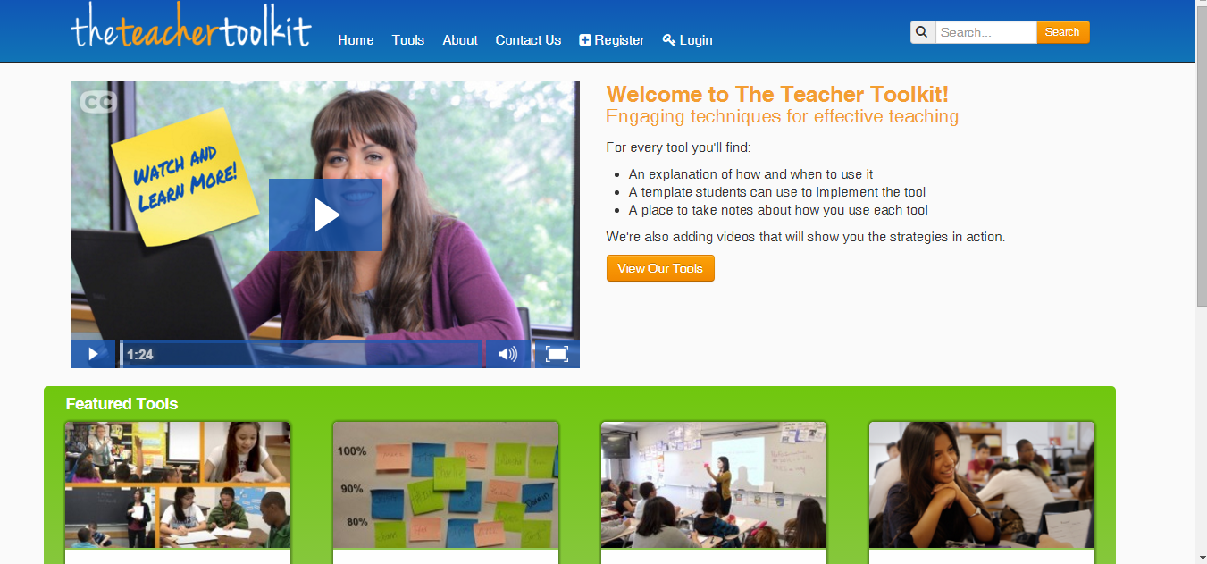
The Teacher toolkit
Lesson Plan – Teaching Strategy
It describes various strategies and has videos for teacher to watch.
This is one of the main websites that the CTE alternative certification program utilizes with their teachers.

Slide 11
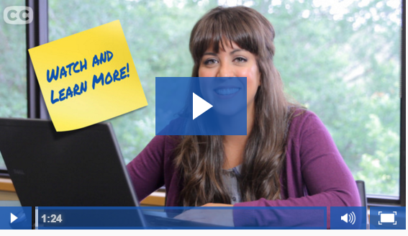
Video

Slide 12
The Teacher toolkit
This website was developed as a project of the Region 13 Educator Certification Program (ECP) Transition to Teaching grant from the United States Department of Education.
The idea for this site came from a long-held practice of our program training. Our teachers always leave our program with a set of Teaching Tools written on index cards and held together with a metal ring, which they use to plan active and engaging lessons for their students. These easy but powerful strategies impact students at all levels and in all content areas.
The purpose of this site is to share these tools with a wider range of novice and experienced teachers in a web based format including video illustrations of the tools in use. The teachers and students you will see on the site are from the Central Texas area and are all successful graduates of our program.
Keep checking back as we add more strategies and video content to our tool kit. Although these tools are presented with novice teachers in mind, teachers of all levels of experience will find them useful with their students

Slide 13
The Teacher Toolkit
Tool Categories:
Classroom Management
Opening Activities
Checks for Understanding
Partner Practice
Group Practice
Independent Practice
Reading Strategies
Games
Closing Activities
View All Tools

